Slide 1
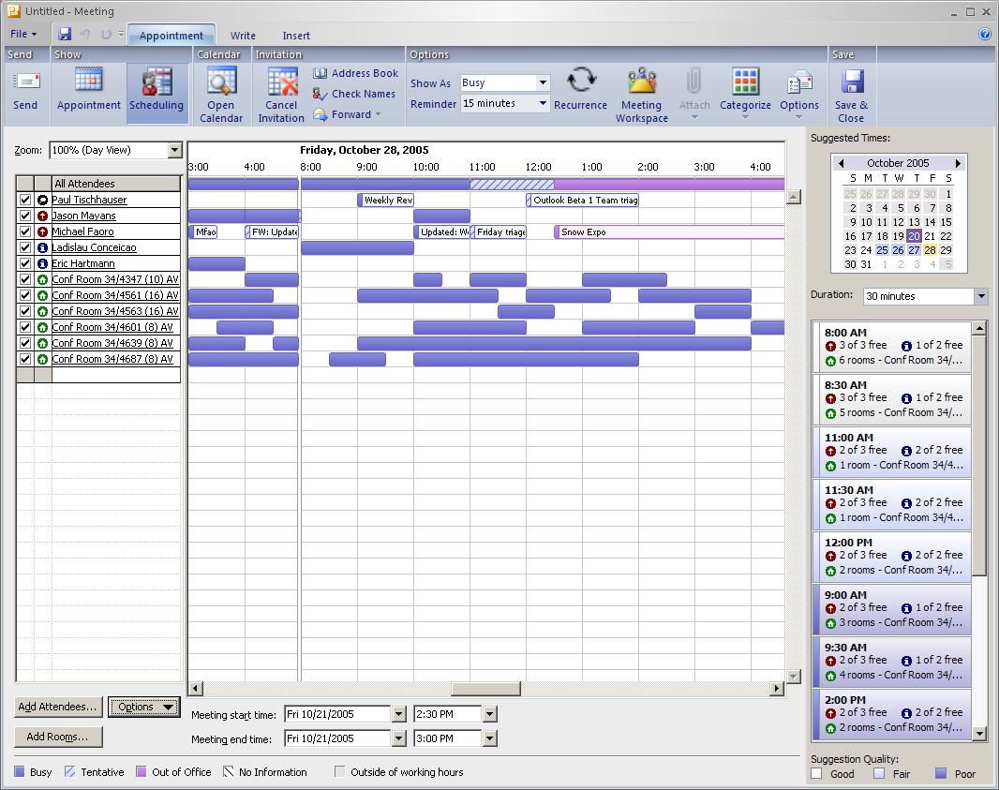
群組排程助理
大家都有
空檔時間
日期
與會人員
會議室
建議時段
越上面越
多人有空
Video: 用OWA預定會議時間
與會議室

Slide 2
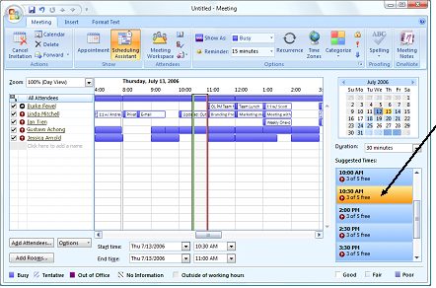
Improved Scheduling Capabilities
Exchange Server 2007 provides recommended meeting times.
Notes:
Improved scheduling capabilities in Office Outlook 2007 and Exchange Server 2007 help you schedule meetings easily and in less time. Exchange Server 2007 looks at the attendee list and recommends an ideal meeting time and location.
A number of other improvements in Office Outlook 2007 make the calendaring experience easier for people using Exchange Server 2003 or Exchange Server 2007. When changes are made to the meeting location or agenda, you receive an informational update rather than having to reaccept the meeting. Additionally, Office Outlook 2007 highlights the changes in the meeting update, making it easier to locate the information that has been modified. All of these changes were designed to make scheduling and updating meetings easier for both the organizer and the attendee.

Slide 3
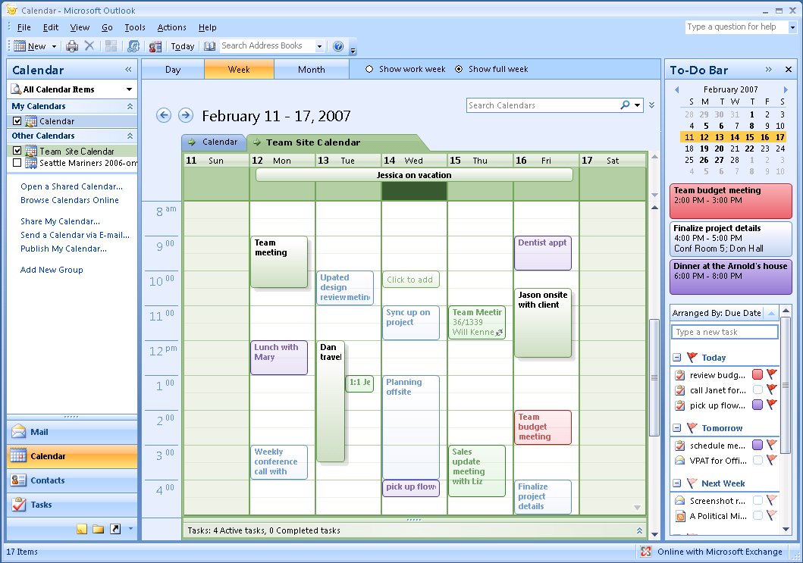
Calendar Overlay
Notes:
When you view calendars in overlay mode, you can navigate multiple calendars on top of one another, making it easier to compare your calendar with a coworker’s or a team calendar to find a free time to meet.

Slide 4
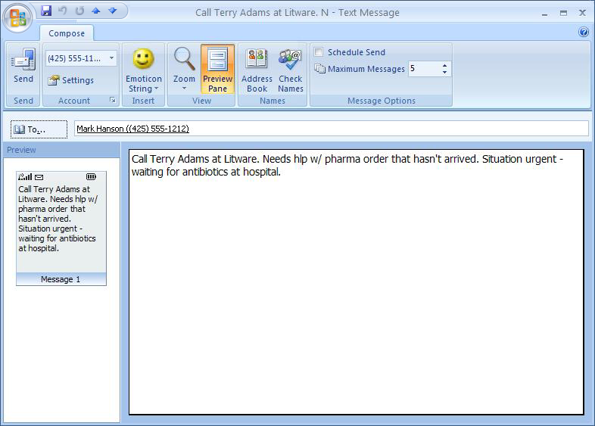
Outlook Mobile Service
Notes:
Outlook Mobile Service is a feature of Outlook that you can use to send and receive text and picture messages between Office Outlook 2007 and any mobile phone. Outlook Mobile Service also enables you to forward Outlook e-mail messages, contacts, appointments, and tasks to yourself or other people as text messages. You can even set Office Outlook 2007 to automatically send e-mail, reminders, and your daily calendar as text messages right to your mobile phone.

Slide 5
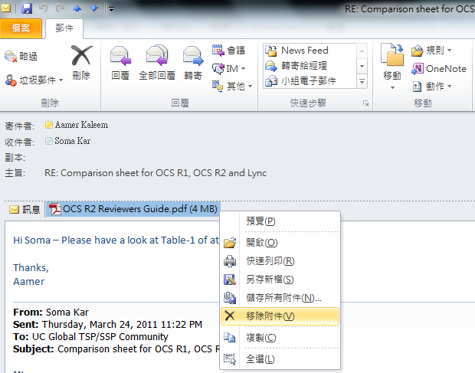
從信件將大附加檔移除

Slide 6
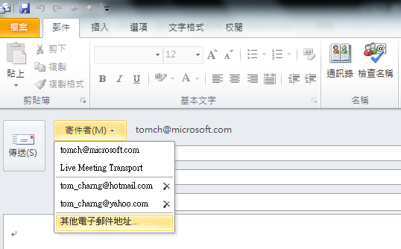
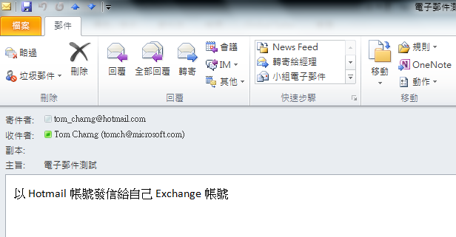
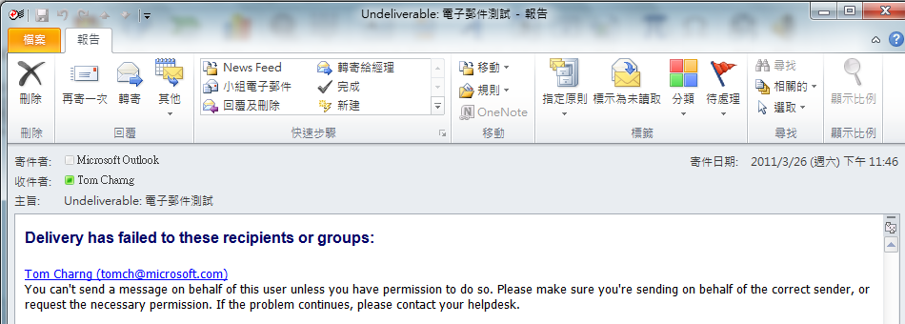
使用其他帳號名義發送郵件

Slide 7
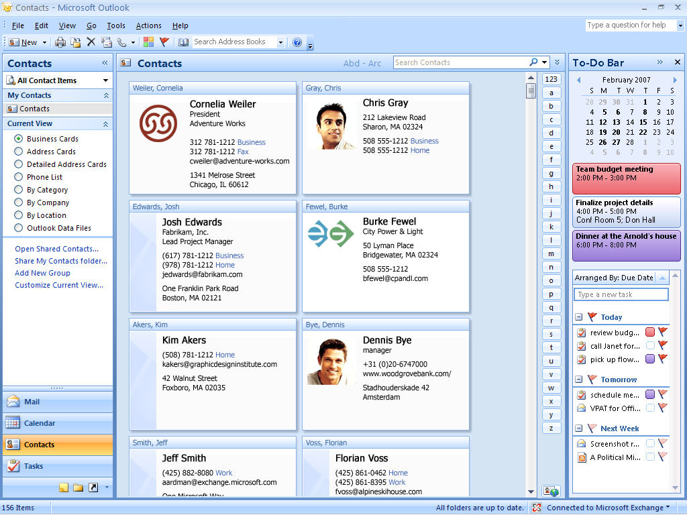
Electronic Business Cards
Notes:
In Office Outlook 2007, you can create and share customized Electronic Business Cards, giving you a personalized way to communicate your information. You can share your card either as an attachment or as part of your e-mail signature. You can use Electronic Business Cards to customize your contact information and add logos and photos, making contacts more personally relevant and easier to locate.
Electronic Business Cards can be exchanged easily through e-mail and saved to your contacts folder. Through improved integration with Windows SharePoint Services, you can connect your team’s SharePoint contacts to Office Outlook 2007. Because of the new, dynamic connection between Office Outlook 2007 and Windows SharePoint Services, any contacts that get added to your team contacts folder on the SharePoint site are replicated to Outlook and vice versa. This way, if a piece of contact information changes, you can modify the contact directly from Outlook and rest assured that anyone else who has connected that contact folder to Outlook also gets the updated information.

Slide 8
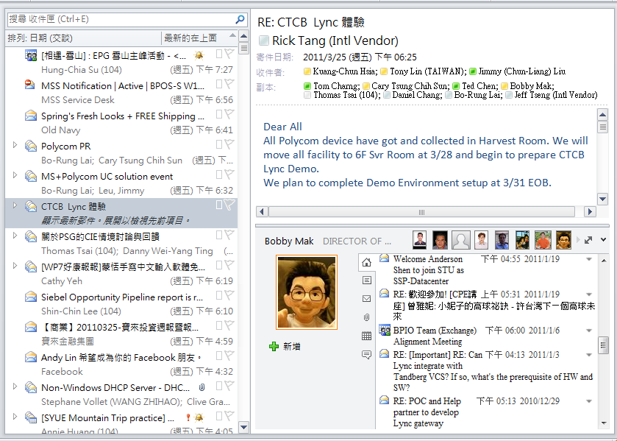
社交網路聯繫

Slide 9
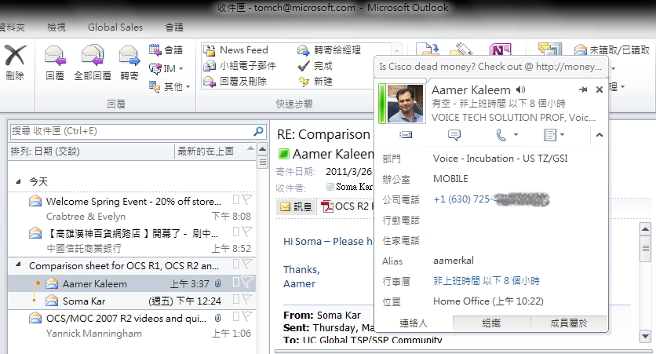
整合通訊的整合應用

Slide 10
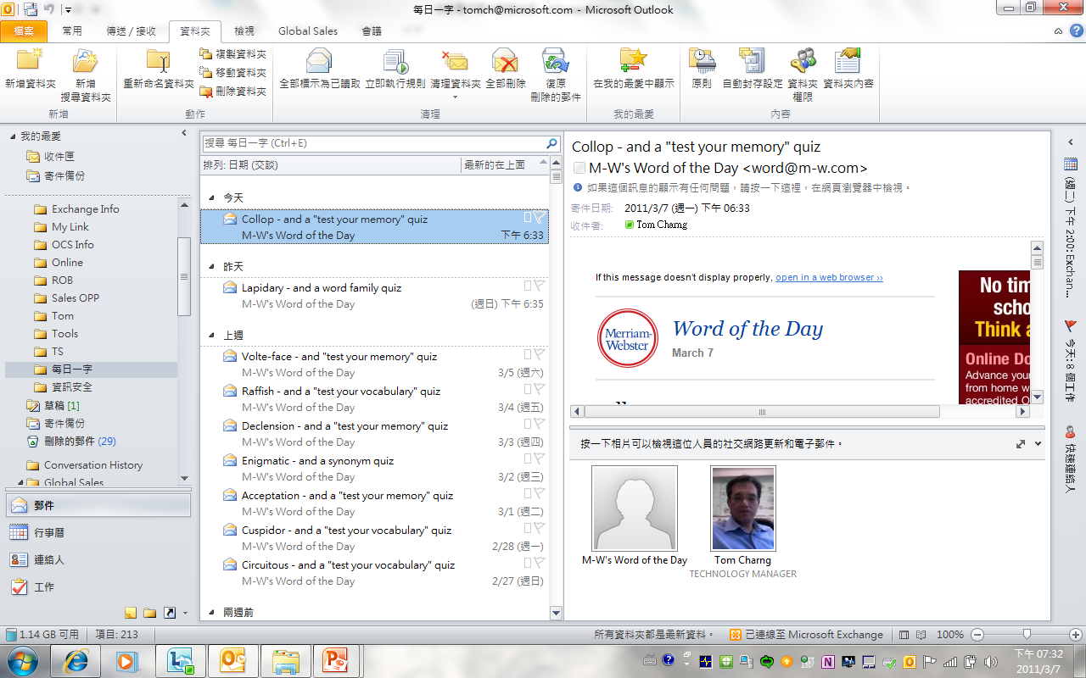

Slide 11
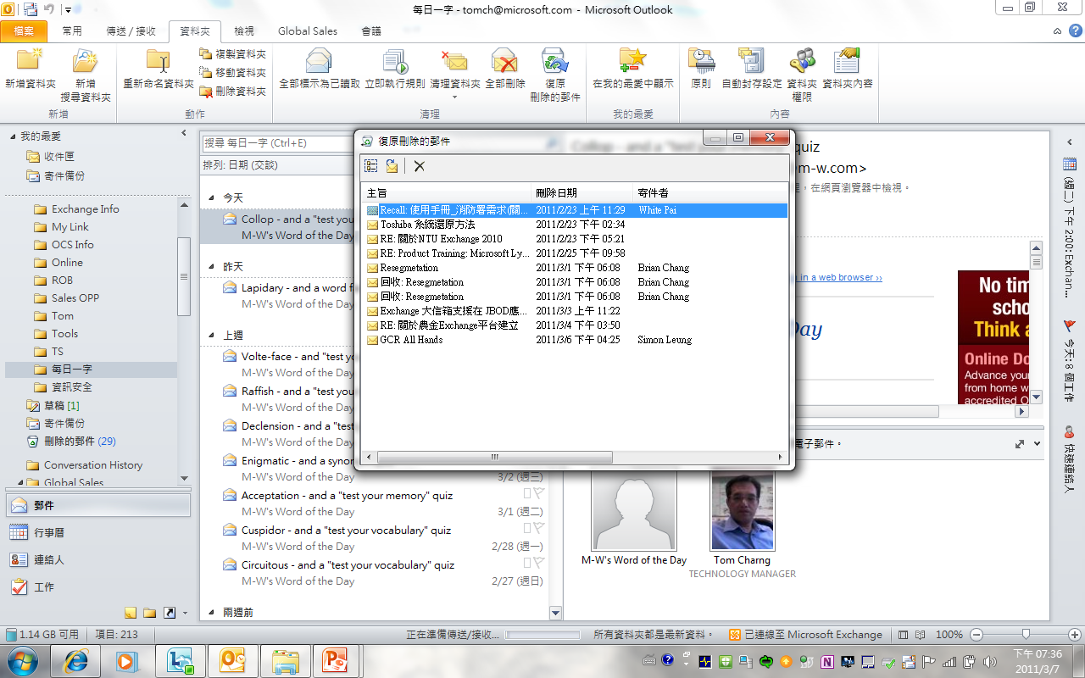

Slide 12
電子郵件如何兼俱安全, 行動與科技的功能
Outlook 與Outlook Express之比較
手機與郵件系統完美結合
-- 快速設定與聰明使用
Smart Phone的應用介紹

Slide 13
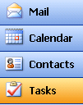
Direct Push Technology
Highlights
Server running Exchange 2003 SP2 above
Device syncs as soon as mail arrives on the server
No reliance on SMS for notifications
Mobile networks allow HTTP request to remain open without battery drain/data cost
No need for a store and forward service
1. Device maintains an open HTTP request with the server
4. Device requests changes from the server and maintains up-to-date state
2. Exchange holds the request open for delivery of notifications and mailbox changes
Windows Mobile Device with MSFP or Licensee Device
3. Exchange notifies device of changes to the mailbox
Notes:
4/18/2011 12:48 PM
13
© 2005 Microsoft Corporation. All rights reserved.
This presentation is for informational purposes only. Microsoft makes no warranties, express or implied, in this summary.
Great, you’ve got it set up. Now how does this actually work?
When the device starts up, it sets up an HTTP with the server. The Exchange server and the device hold this connection open while waiting for notifications. Due to the nature of mobile networks, this connection can remain open without any data being transmitted and without any charges. When an email arrives the Exchange server uses this connection to notify the device of this new message. The mobile device will then retrieve this message from the server. The total transaction to get the message takes only a couple of seconds, often less time even than it takes to see the message in Outlook.

Slide 14
行動郵件解決方案比較
業者 | Microsoft Exchange | TCC | RIM Blackberry | FET | CHT
服務名稱 | Push-mail DIY | 即時郵 (M-email) | Mobile e-mail | 任意郵 | 快遞郵
目標客戶 | 企業用戶 | 企業用戶 | 企業用戶及個人 | 企業用戶 | 企業用戶及個人
結盟廠商 | Open | Microsoft | RIM | Seven Networks | 卡米爾
支援功能 | Mobile PIM | Mobile PIM | Mobile PIM | Mobile PIM | Mobile PIM
終端設備 | WinCE, Symbian | WinCE, Symbian | Blackberry Device | WinCE, Symbian | Java 智慧型手機 一般手機
Push Email | Wi-Fi & GPRS auto push | SMS+GPRS (自動下載) | GPRS (Auto Push) | GPRS | GPRS
系統建置 | 在Exchange Server 2003設定即可 | 在Exchange Server 2003設定即可 | 需建置Blackberry Enterprise Server | 需在個人PC及手機上加裝agent, 並同時開機 | 需建置快遞郵Server, 以便於跟CHT Carrier Server 串連
費用 | 手機硬體費用 GPRS資費 | 手機硬體費用 GPRS資費 | Blackberry手機硬體費用 Blackberry server 及使用者授權費用 GPRS 資費 | 服務月租費100/月 手機硬體費用 GPRS資費 | 手機硬體費用 GPRS資費 Server 設定費及授權費用
特點 | 毋需在E-mail及終端設備上安裝中介軟體 支援各大行動業者及Wi-Fi無線網路 與Outlook看齊的使用經驗及安全強化 | 毋需在E-mail及終端設備上安裝中介軟體 支援各大行動業者及Wi-Fi無線網路 與Outlook看齊的使用經驗 | 多配備小鍵盤, 對於西方語系使用者而言, e-mail處理功能佳 支援各大電信業者 支援各主流e-mail server, 但相對影響performance | 支援各主流e-mail server 個人PC需開機 | 支援各主流e-mail server Carrier Server 會有郵件複本
Notes:
Innovate – Exchange / Mobility SI

Slide 15
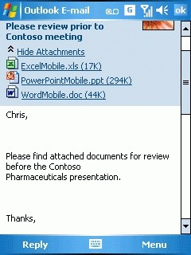
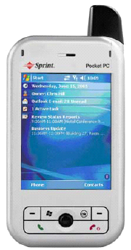
E-mail Access
Access e-mail at any time
View attachments
Use hotlink URLs, phone numbers
Listen to internal messages with voicemail .wav
Notes:
Key Messages
With true Outlook e-mail functionality, you can send and receive e-mail messages and view attachments. You can access up to six different messaging accounts.
Speaker Script
Outlook Mobile gives you the familiar Outlook experience on your device with many of the same features and functionality. Besides accessing e-mail messages at any time, you can send messages quickly with auto-completing addresses and view and send Office document attachments. You can also click on live URL hyperlinks and phone numbers in the message body, plus listen to voicemail message .wav files.

Slide 16
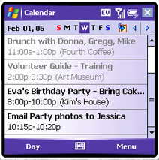
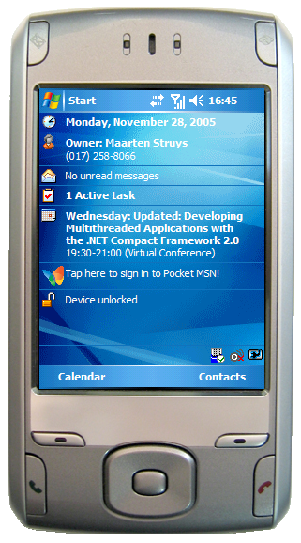
Calendar Access
Receive meeting reminders
Check meeting locations
Change appointments
Accept or decline meetings
View attendee lists
Call a conference bridge
Notes:
Key Messages
You can synchronize your calendar, receive reminders on upcoming meetings, check meeting locations, and see the calendar in day, week, month, and year views.
Speaker Script
Imagine that as you’re walking to your car on your way to a meeting, you receive a call on your Windows Mobile–based Smartphone. "Can you shift tomorrow afternoon's meeting from 1:00 P.M. to 2:00 P.M.?" the caller asks. No need to return to the office. You put the caller on hold and quickly open your Outlook calendar. On the Windows Mobile–based Smartphone, you consult your schedule and see that you’re free at 2 P.M. tomorrow. You update the meeting in your schedule and then confirm with the caller. With Direct Push technology, your Outlook calendar is now updated with the meeting change.
After struggling to find a parking spot, you arrive at your meeting building with just a few minutes to spare. Which room was that meeting in? Again, you pull out your Smartphone and check your calendar for the meeting location.
As you can see, your Outlook Mobile calendar has much of the same functionality as Outlook on your laptop or desktop. You can receive meeting reminders, accept or decline meetings, and view the meeting attendee list. You can even call a conference bridge from the calendar screen (but you still have to enter the passcode manually).

Slide 17
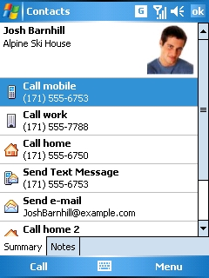
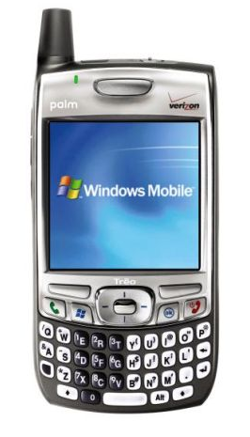
Global Address List and Contacts Access
Add new contact from e-mail
Call contact from contact list
Share contacts between devices
Global address list (GAL) lookup
Notes:
Key Messages
You can easily add a new contact from an e-mail message or call the message sender directly by clicking the e-mail header.
You can synchronize your contacts with your desktop system and call contacts directly from the contact list.
With MSFP you can browse the corporate global address list directly from your mobile device.
Speaker Script
In Outlook Mobile, you can easily switch between e-mail messages and your contact list. From an e-mail message you can add the sender or other recipients to your contact list with just a click, you can call a message sender directly by clicking the e-mail header, or you can call a contact directly from the contact list. On devices equipped with voice command software, you can press your voice button, speak the name of a contact on your contact list and, after you confirm the name, the device will dial the number. The new search and filter feature in Outlook Mobile makes it easy to find contacts. You can synchronize your contacts with your desktop system and share contacts between devices.
In addition to your stored contacts, you can now access your corporate global address lists (GAL) over the air from your device powered by Windows Mobile 5.0 with MSFP. The contact chooser interface that enables access to both types of contacts is embedded within the messaging, phone, calendar, and speed-dial menus. You can search for additional contact details not stored locally on your mobile devices, send e-mail messages or meeting invitations to individuals in your company who may not be stored in your personal contacts list, and browse the GAL for additional contact details such as office location. Once a contact has been located, you can store his or her information on your mobile device and add him or her to your mobile device contacts list.
So, imagine that you’re in the field and want to contact an expert but don’t know the contact information. With GAL lookup, you can find the contact information directly from your mobile device and phone or send an e-mail message to that person.
17

Slide 18
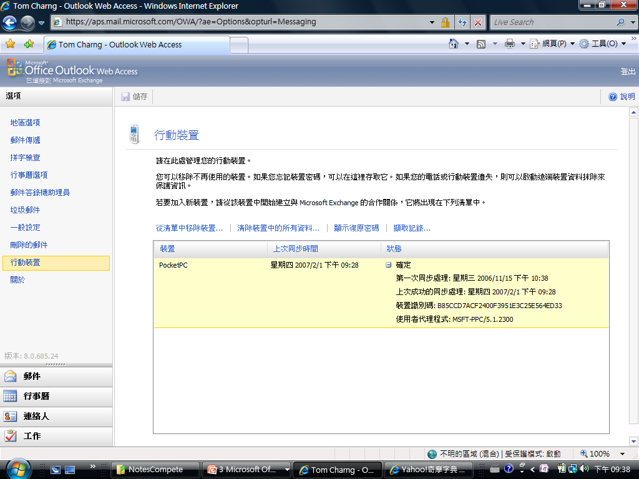
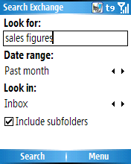
Remote Wipe

Slide 19
電子郵件如何兼俱安全, 行動與科技的功能
Outlook 與Outlook Express之比較
手機與郵件系統完美結合
-- 快速設定與聰明使用
Smart Phone的應用介紹

Slide 20
Movie Show

Slide 21
Q & A

Slide 22
© 2009 Microsoft Corporation. All rights reserved. Microsoft and other product names are or may be registered trademarks and/or trademarks in the U.S. and/or other countries.
The information herein is for informational purposes only and represents the current view of Microsoft Corporation as of the date of this presentation. Because Microsoft must respond to changing market conditions, it should not be interpreted to be a commitment on the part of Microsoft, and Microsoft cannot guarantee the accuracy of any information provided after the date of this presentation. MICROSOFT MAKES NO WARRANTIES, EXPRESS, IMPLIED OR STATUTORY, AS TO THE INFORMATION IN THIS PRESENTATION.

