Slide 1
電子郵件如何兼俱安全,
行動與科技的功能
台灣微軟
技術經理 Tom Charng

Slide 2
電子郵件如何兼俱安全, 行動與科技的功能
Outlook 與Outlook Express之比較
手機與郵件系統完美結合
-- 快速設定與聰明使用
Smart Phone的應用介紹

Slide 3
Outlook Express 與 MicroSoft Outlook
Outlook Express是屬於Windows XP作業系統所附贈的軟體，功能比較簡單。
MicroSoft Outlook是屬於Office軟體內建軟體的版本，它的功能比Outlook Express多，而且也比較強，比較適合辦公室的人使用這套軟體。

Slide 4
Outlook Express 與 Microsoft Outlook
功能 | Outlook Express | Microsoft Outlook
收發電子郵件 | ✓ | ✓
個人通訊錄 | ✓ | ✓
行事曆 |  | ✓
工作管理 |  | ✓
郵件規則 | 簡單 | 完整
安全性要求* | 低 | 高
註：安全性要求是指MS Outlook會限制一些不安全的行為，如傳送.exe的附檔。

Slide 5
Version/Feature Matrix
 | Exchange 2003 (SP2) | Exchange 2007 (SP1) | Exchange 2010 (RTM)
Outlook 2007 | Outlook Anywhere
 | RMS email
 |  | Managed Folders
 |  | Sender ID Anti-Spam
 |  | AutoDiscover Settings
 | Cached mode
 | Reduced Network traffic (50-70%)
 |  | Server Search
 | Search Folders
 |  | Resource Booking Attendant
 |  | Schedulable OOF
 |  | Internal/External OOF
 |  | Voicemail
 |  | Scheduling Assistant
 |  | Share Calendar Information
 |  | Calendar Attendant
 | Exchange 2003 (SP2) | Exchange 2007 (SP1) | Exchange 2010 (RTM)
Outlook 2003 | Outlook Anywhere
 | RMS email
 | Cached mode
 | Reduced Network traffic (50-70%)
 | Search Folders
Security and Control
Color Key
Performance
Productivity

Slide 6
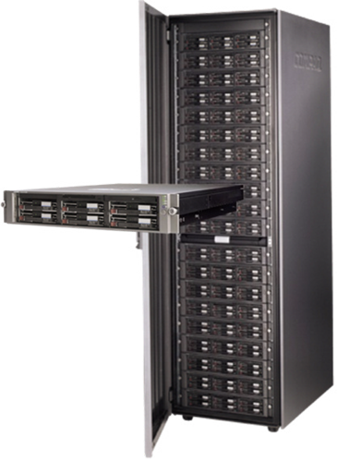
微軟智慧型電子郵件解決方案
電子郵件
群組行事曆
連絡人
待辦事項
語音信箱
記事
組織通訊錄
線上信箱封存
即時訊息
RSS
手機簡訊
提供一個讓您一次就可以讀取屬於您所有訊息的地方.
Notes:
Talking Points:
A universal inbox means all of your means of communication come into one place. This makes it easy to see all the ways people have communicated with you at once as well as gives you one place where you can go to find the information you want. Whether it’s responding to a message you just received, or looking up a customer response you sent nine months ago; a universal inbox means one place to go to find what you want and to receive what you need.
Slide Takeaways:
Exchange Server 2010 helps unify your communications by placing many of your critical messages in one inbox for easy consumption, production and retention.

Slide 7
工欲善其事必先利其器
PC & MAC
電話
(企業訊息中心)
瀏覽器
Notes:
Talking points:
Outlook:
Outlook Web App:
Outlook Mobile:
Slide Takeaways:

Slide 8
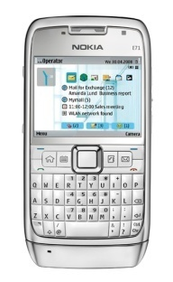
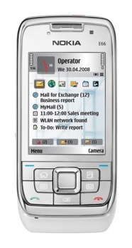
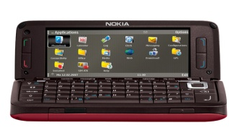
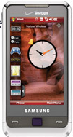
支援更多行動裝置
Apple
Notes:
Situation:
Mobile devices are a heterogeneous group these days. IT Admins need to know which ones they will support.
Talking Points:
Licensees get access to Microsoft’s Exchange ActiveSync Patents and protocol specifications. Many of the worlds most used smartphones come with (or have available) Exchange ActiveSync clients that give native connectivity to Microsoft’s Exchange Servers.
Not only those listed but:
Apple, Big Bang Systems, DataViz, HTC, NitroDesk, Nokia, Notify Corp., Palm, Remoba, Samsung, Sony Ericsson, Symbian, Virgin Mobile, and others are planned.
No matter what device users choose, there is almost always an Exchange ActiveSync solution available, either out of the box (in many cases) or from a 3rd party ISV.
Slide Objective:
Allow people to realize that choosing exchange for mobility give them large amounts of freedom in choosing which devices they support.

Slide 9
Outlook 2010 效能更好更快
Outlook 效能更好更快
啟動至少快提升25％
下載新郵件速度提升30％
讀信，文件，法規 - 減少工作流程中的停頓34％
關機時間少於 10秒在96％的Beta 2使用客戶.
可以使用大的儲存設備
提升最大檔案大小2.5倍（20GB到50GB的）
大大提高處理 multi-gigabyte 信箱和歸檔文件能力
Notes:
During the development of Outlook 2010, we focused on making everything faster. We see that falling in to 2 categories: we made Outlook faster, and we made you faster.
Let’s break that down. Making Outlook faster is about making it quick to get the things done you typically do in Outlook. For instance, we improved startup so that you can get to your Inbox faster. We improved download time so that you can see new mail right away. We improved underlying architecture to make common operations quicker such as clicking to read a mail, moving mails to other folders, and switching to those folders. The mantra during development was to leave the user in control – that is, you’re not waiting on Outlook to perform your next task. We also wanted to complete the cycle by making shutdown fast as well – Outlook starts up and goes away as fast as you want it to.
Additionally, we know that not everyone can keep their room clean. Not only did we improve the performance of small Inboxes, but for people with large Inboxes and piles of mail everywhere, Outlook 2010 can handle the volumes. We’ve increased our maximum supported file size by 2.5x and vastly improved the ability for Outlook 2010 to cut through multi-gigabyte mailboxes and archive files.
Startup details: cached exchange, cold boot on a 3GB store: 10.3s (O12 SP2)→7.6s (O14). Warm boots, obviously, are faster than this raw timing and are also improved over SP2.
Sync details: 18.6mins (O12 SP2) → 12.7mins (O14) on a 1GB store.
Pauses details: 41 300ms pauses (O12 SP2) → 27 300ms pauses (O14) for an 11 minute workflow. If comparing 1 second pauses, the count went from 6 (O12 SP2) to 4 (O14).
Shutdown details: (PerfTrack) takes less than 4 seconds for 78 of Beta 2 customers. takes less than 5 seconds for 83% of Beta 2 customers. 92% of Beta 2 customers shut down in less than 10 seconds. (From SQM): 86% take less than 4 seconds, 96% take less than 10 seconds.

Slide 10
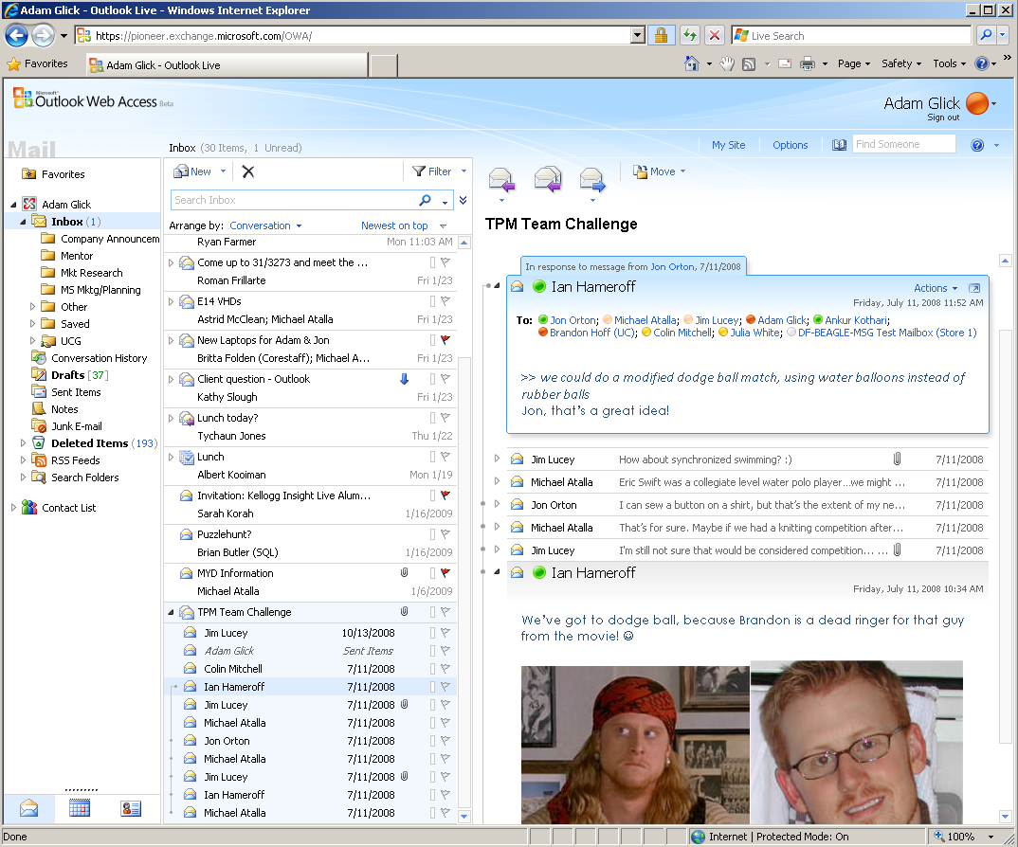
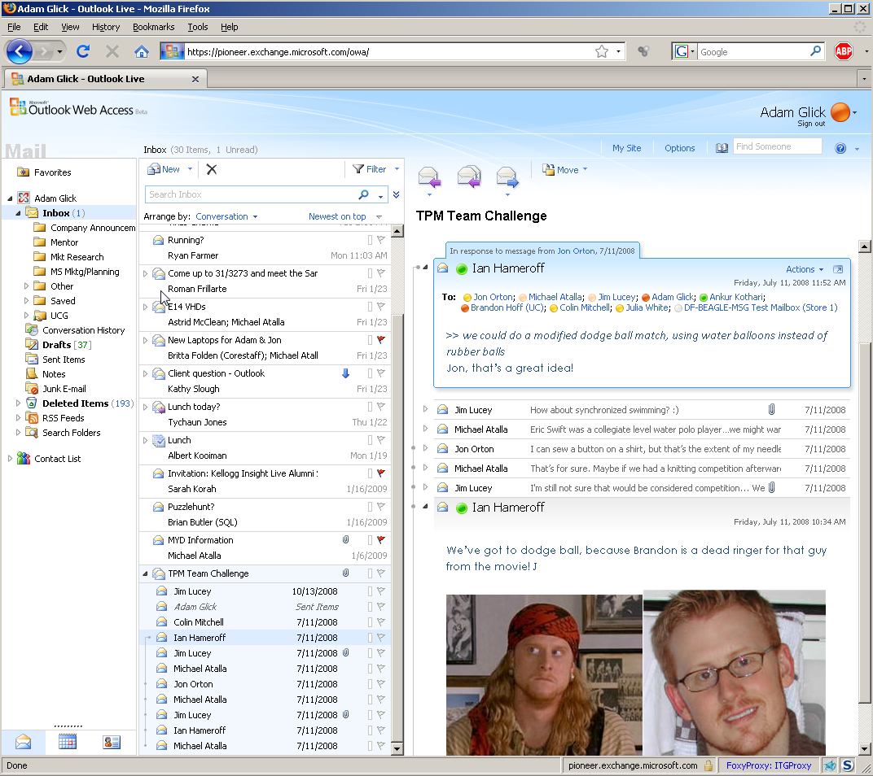
OWA Browser Support
OWA Premium
OWA Lite
Notes:
Situation:
OWA users have traditionally used IE if they wanted to get the OWA premium experience.
Talking Points:
OWA is now supported on IE, FireFox (PC & Linux) and Safari (Mac only)
Only differences are around Active X controls (Inline UM player, S/MIME control)
Slide Objective:
OWA now supports all three major borwsers.

Slide 11
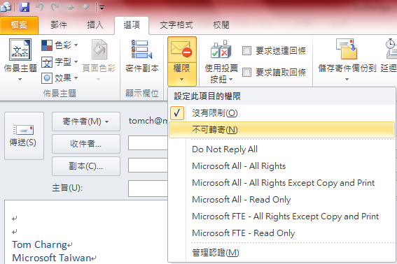
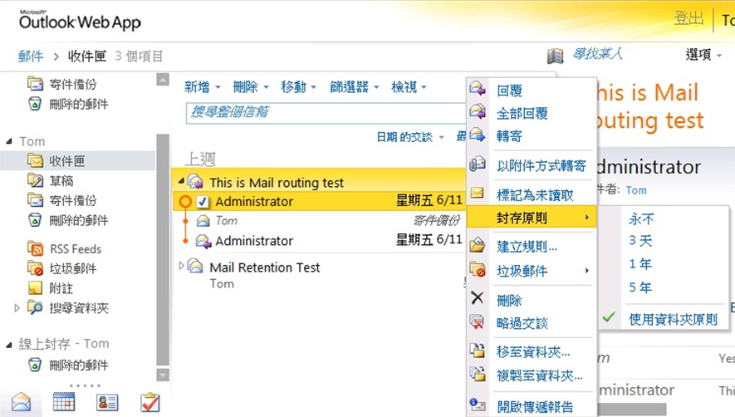
最佳風險控管
在不改變使用者及IT專業人士的經驗下,提供電子郵件保護，保存和收搜尋等功能
防止惡意軟件和垃圾郵件進入到郵件訊息環境
Hosted Service
數位資訊版權保護
On-Premises Software
線上信箱
封存
郵件保留規則
Notes:
Exchange simplifies and automates the process of protecting your organization’s communications and meeting regulatory requirements
Situation:
Tighter regulatory requirements and growing email volumes require greater vigilance to prevent data breaches.
Slide Objective:
Show how Exchange can help customers better manage risk by complying with security and governance needs
Talking Points:
Protect, preserve and discover email data without changing the user or IT pro experience
Exchange Server 2010 adds integrated information protection, control, and compliance tools to help simplify and automate the process of protecting your company’s communications and meeting regulatory requirements.
New, integrated email archiving capabilities support preserving and discovering email data without changing the user or IT Pro experience. For example, users can easily “drag and drop” emails from their .PST files into a new Exchange 2010 personal archive, which looks just like another email folder. Users can easily access archived email in both Outlook 2010 and Outlook Web App, helping you eliminate the proliferation of .PST files on your network.
Users can easily read and author IRM-protected messages natively through Outlook Web App without plug-ins or extra steps.
Prevent malicious software and spam from entering into the messaging environment
Exchange better protects data with automatic encryption at both the network and message levels.
Exchange isolates spam with built-in, multi-layered filtering and continuous updates.
Exchange leverages advanced APIs to easily integrate leading anti-virus software.

Slide 12
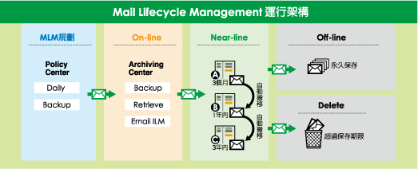
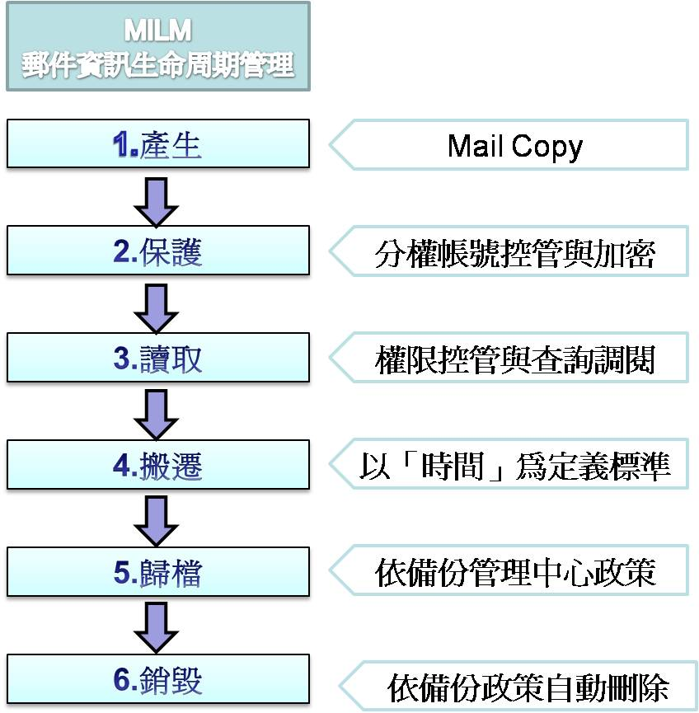
郵件生命週期
記錄資料需保留
至少二年、最多五年
依據個資法第30條損害賠償請求權，自請求權人知有損害及賠償義務人時起，因二年間不行使而消滅；自損害發生時起，逾五年者，亦同
依據個資法第29條非公務機關違反本法規定，侵害當事人權利者，負損害賠償責任。但能證明其無故意或過失者，不在此限
12
P.12
Notes:
版權共有.中華數位.

Slide 13
Exchange 2010 個人信箱封存
Edge Server
HUB Transporter
Server
Mail Box Server
個人信箱線上封存
Client Access Server
個人信箱封存(本地)

Slide 16
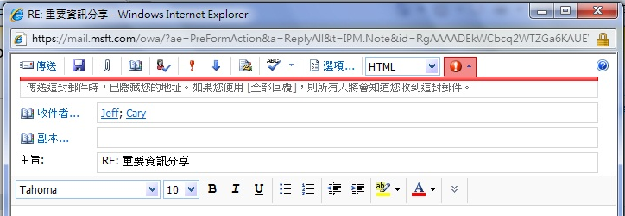
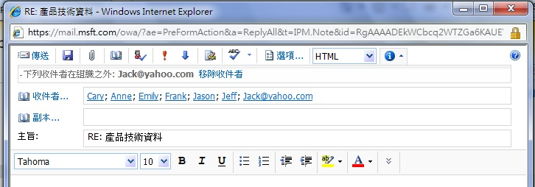
郵件提示(MailTips)
使用者部份:
早期預警系統
不在辦公室 (OOF)
外部收件者
回覆自己在郵件副本的信件 (BCC)
郵件仲裁群組 (DL)
限制收件人
提示不能執行的作為
發送大量使用者的通訊群組L發送受限制的通訊群組
郵件大小
郵件信箱已滿
系統部份:
避免不必要的伺務器負載
避免違反政規定
可客製化的郵件提示
Notes:
Slide Objective:
Instructor Notes:

Slide 17
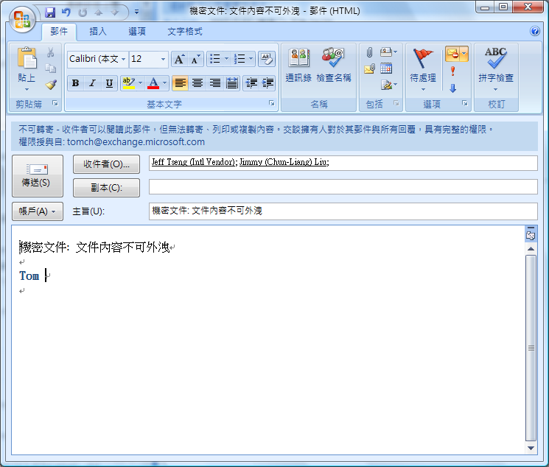
整合RMS(Windows Rights Management Services)

Slide 18
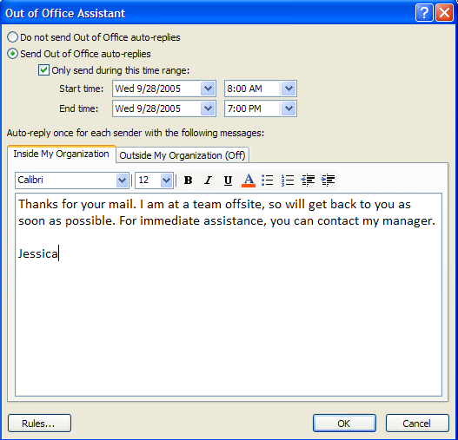
郵件答錄機
可設定啟始與結束時間
可設定對內部同事與對外部來信不同的回應訊息
Rich HTML Out of Office messages
Notes:
18

Slide 19
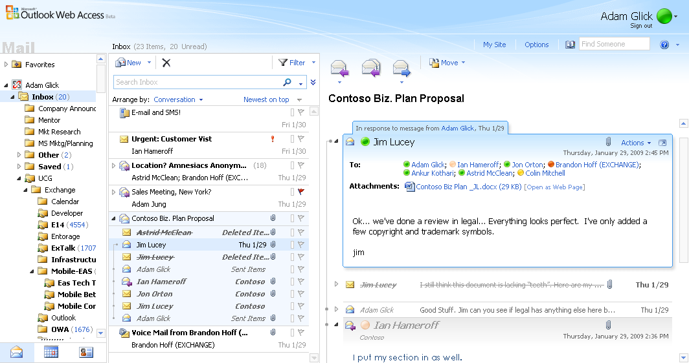
電子郵件交談示檢視
Identify the reply trail and message forks
Duplicated information is removed
Move an entire conversation
See all messages in a conversation in one view
Conversation view consists of the list view and the reading pane
Expand or collapse conversations and individual messages
See the number of unread messages
No paging through e-mails
Notes:
Slide Objective:
Instructor Notes:
Situation (demo slide, can be removed if demo can be done).

Slide 20
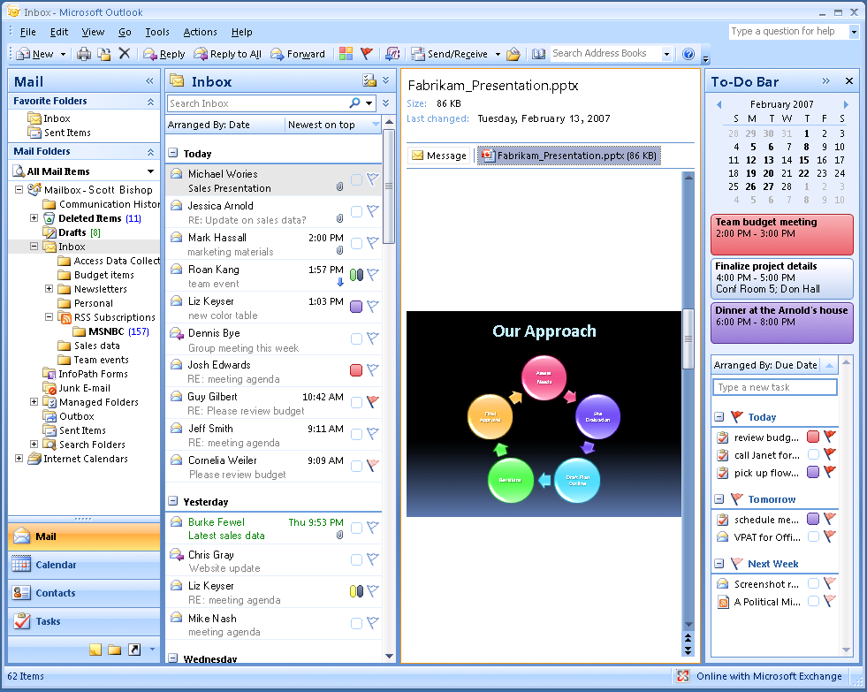
Attachment Preview
Notes:
Accessing attachments is often a tedious, multi-step process. In previous releases of Outlook, there was no easy way to gain insight into an attachment without opening it. With Attachment Preview, you can view your attachments in one click directly from within the reading pane. This saves you time because you can view attachments in context with the e-mail message.

Slide 21
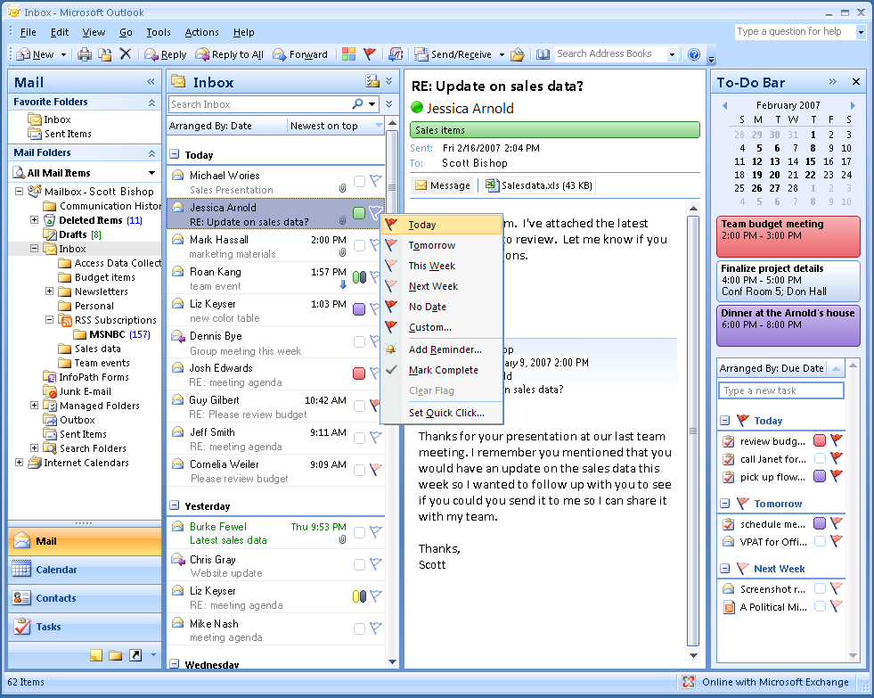
Flagging Mail as Tasks
Notes:
Often tasks are contained within e-mail, so getting tasks into your task list used to mean manually entering the information. With new mail flagging in Office Outlook 2007, that is no longer the case. With Flagging Mail as Tasks, you can create a task from your e-mail in one simple step. Simply right-click to flag your message and designate a date for completion. The item is then added to your To-Do Bar and the due dates are integrated automatically into your calendar.

Slide 22
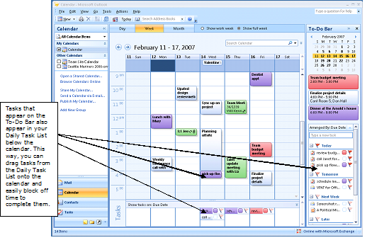
Task Integration on the Calendar
Notes:
Previously you may have scheduled fake appointments on your calendar to account for the time your tasks would take. Office Outlook 2007 integrates tasks on the calendar in the Daily Task List so that you see them displayed beneath your daily appointments and meetings. To allot time for working on a task, you simply drag the task onto your calendar. When you complete a task on a given day, the task “sticks” to that day, providing a visual record of the work you performed. Tasks you do not complete roll over to the next day and accumulate until you mark them as complete.

